Slide 1
Improving Polygenic Risk Prediction using Local Ancestry From Simulated and Real Admixed Populations
02704A - Introduction to Statistical Genetics, Fall 2024
Shashank Katiyar, Darin Boyes

Slide 2
Introduction
Motivation - Current PRS methods only focus on individuals with distinct primary ancestry. Accounting for mosaic structure can increase power.
Goal - Increase power of PRS methods by accounting for local ancestry information alongside individual genotype data.
Approach - Using HapMap3 dataset, predict local ancestry probabilities of real and simulated admixed genotype data. Then, use local ancestry information and individual genotype data to perform polygenic risk prediction for diseases with known correlation (or lack of) to admixture.

Slide 3
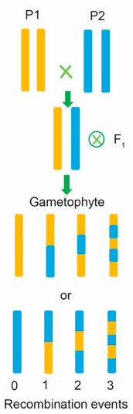
Simulating Admixed Population
CEU
YRI
Between CEU and YRI population
randomly sample one individual from each population
retrieve geno data
Model number of recombination events as following a Poisson distribution
# recombination events = λd
λ = 0.01 crossovers / cM
d = total cM across genome
Simulated
genotypes
distribute λd recombination events across the genome

Slide 4
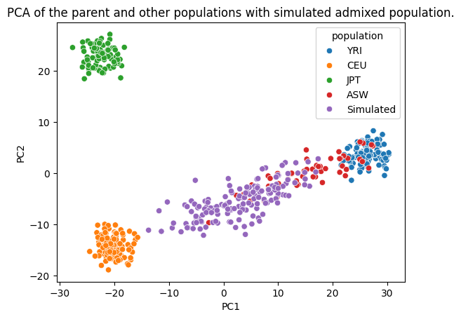
Results: PCA
Performed PCA using the top 3000 high-variance SNPs. Results with more SNPs were identical.
Simulated population and actual admixed population (ASW), both are clines between parent populations
Notes:
Subsettted to 3k snps and why
Nicely in a cline as we expect
Asw slightly closer to yri than ceu, not sure why

Slide 5
Admixture-LD computation
Bin 1
Bin 2
Computed average SNP-correlation corresponding to each pair of bins
For all bins pairs at a particular distance, took the average of their SNP-correlation
Did this for all populations to get an estimate of LD between SNPs with increasing distance

Slide 6
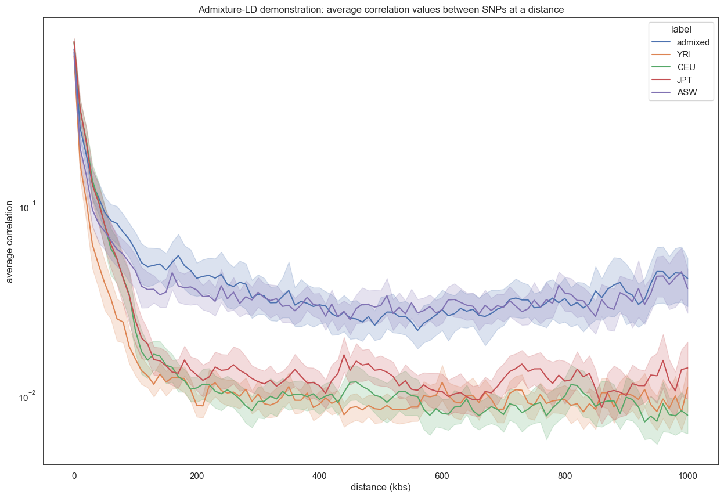
Results: Admixture-LD
With increasing bin distance, avg snp correlation values drop for admixed and simulated populations
Average LD between SNPs at increasing distance
(chr1, 1000 bins of size 10kb)
With increasing bin distance, avg snp correlation values drop for non-admixed populations

Slide 7
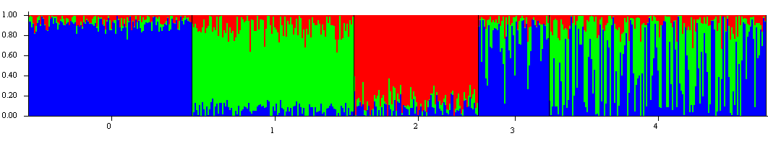
Results: Model Based clustering using STRUCTURE
YRI
CEU
JPT
ASW
Simulated
Similarity between ASW and Simulated data’s composition
Used K = 3 as there were 3 populations which were different in originality
ASW individuals have generally more African composition as is indicated from the PCA plot too

Slide 8
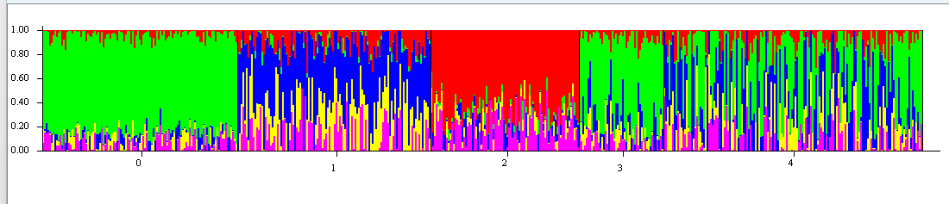
STRUCTURE with K = 5.

Slide 9
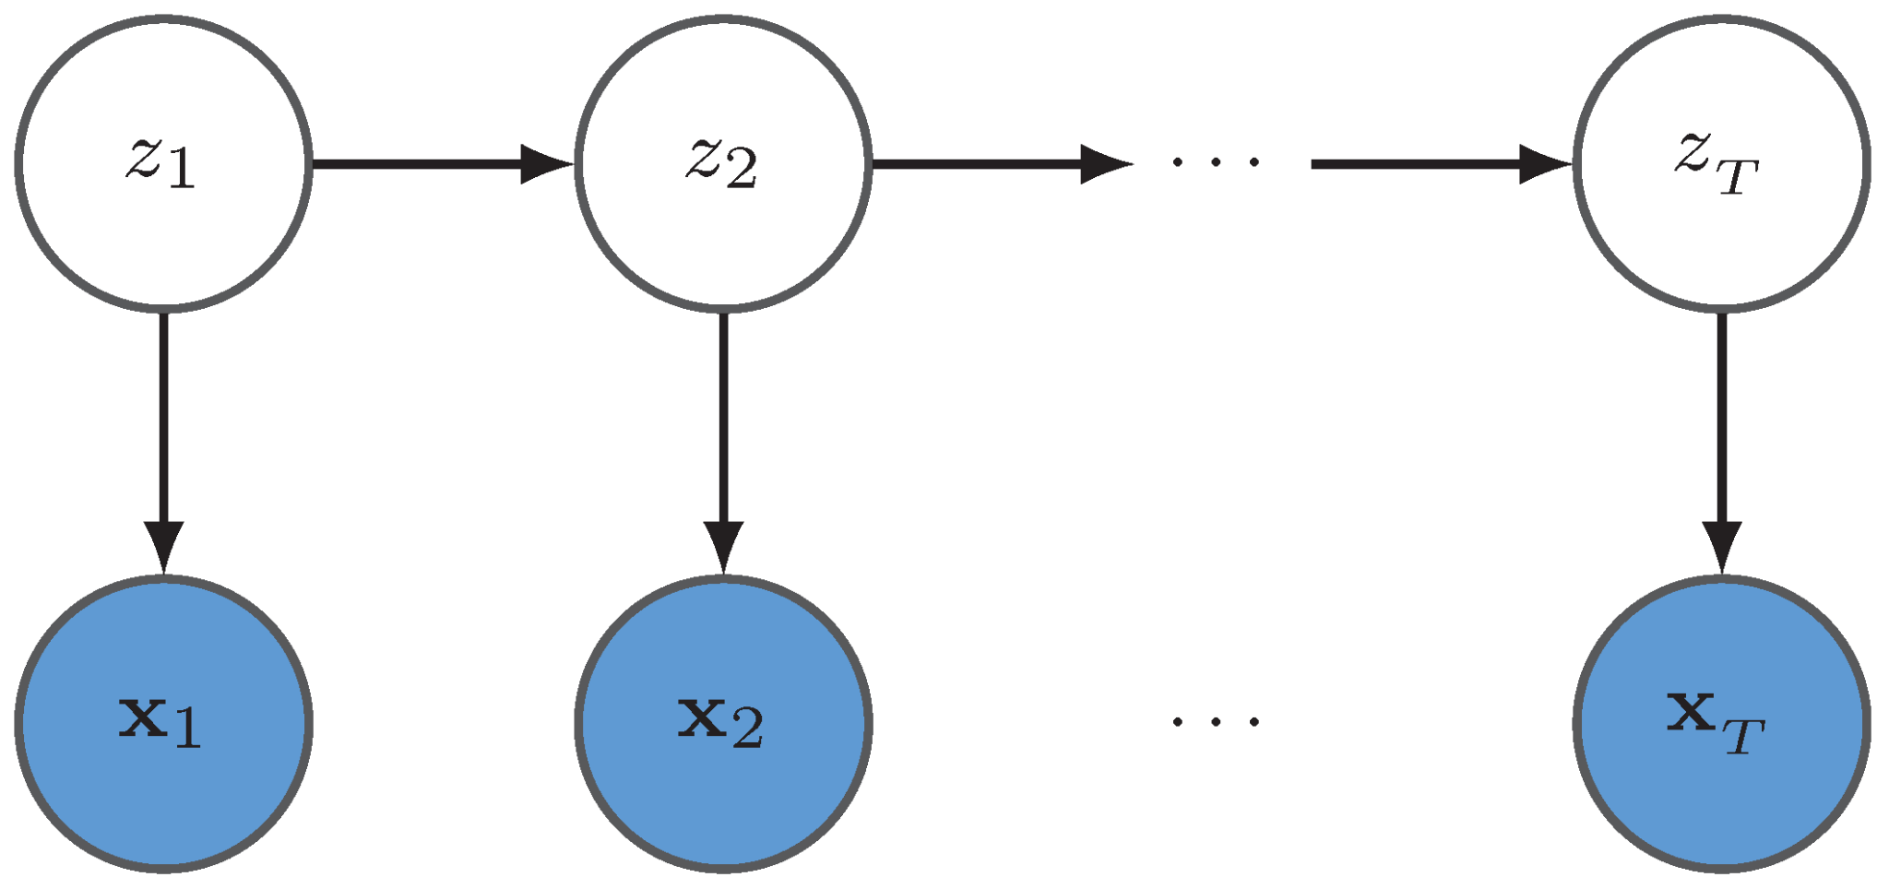
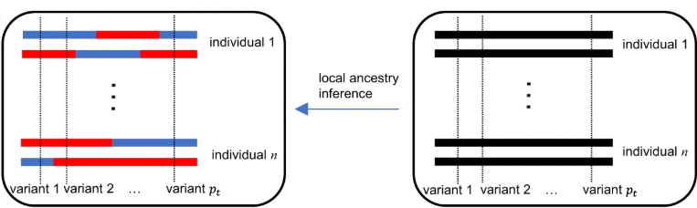
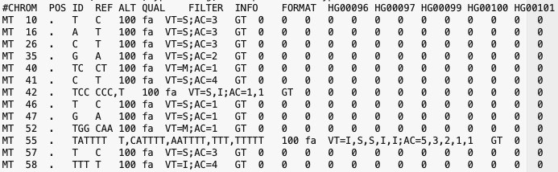

Local Ancestry Prediction
using FLARE
Input:
chromosome map file with physical (bp) and genetic distances (cM) on chromosome for each snp
reference genotype data for CEU and YRI populations in VCF format
admixed sample genotype used for local ancestry inference
Output:
ancestry file containing local ancestry probabilities for each individual and SNP
contains probabilities of belonging to CEU and YRI populations
YRI
CEU

Slide 10

Polygenic Risk Prediction of Admixed Populations using GAUDI
A = ancestral population A
B = ancestral population B
p = # SNPs
β_{A, j} = effect size of SNP j for
population A
β_{B, j} = effect size of SNP j for
population B
x_{i,j} = genotype information of individual i at SNP j
l_{i,j} = local ancestry for individual i at SNP j
G - Genetic
A - Ancestry
U - Utilization (in polygenic risk scores for)
D - aDmixed
I - Individuals

Slide 11
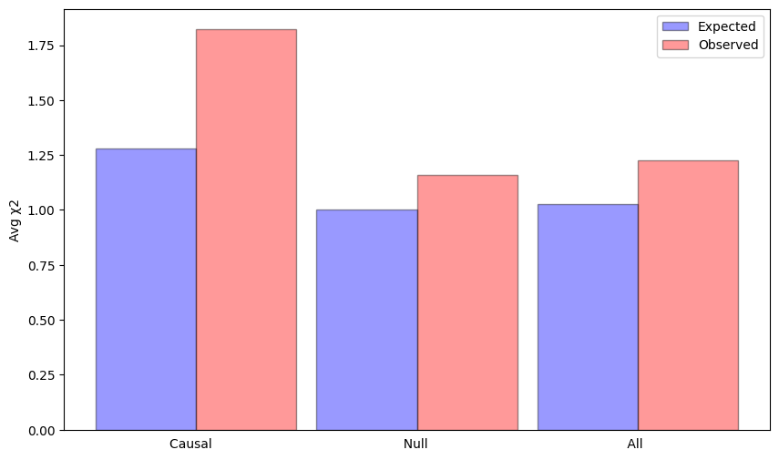
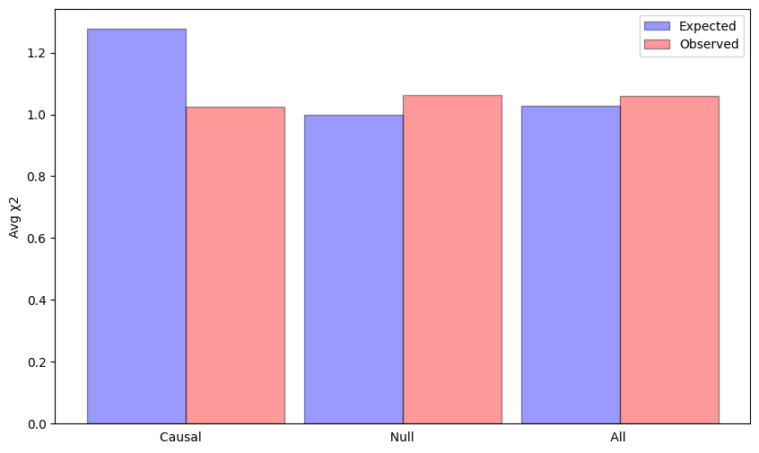
Type 1 Diabetes PRS for ASW data
Normal PRS χ² values
 | Expected | Observed
Causal | 1.278 | 1.824
Null | 1 | 1.160
All | 1.028 | 1.226
Normal PRS
GAUDI
GAUDI PRS χ² values
 | Expected | Observed
Causal | 1.278 | 1.025
Null | 1 | 1.064
All | 1.028 | 1.060

Slide 12
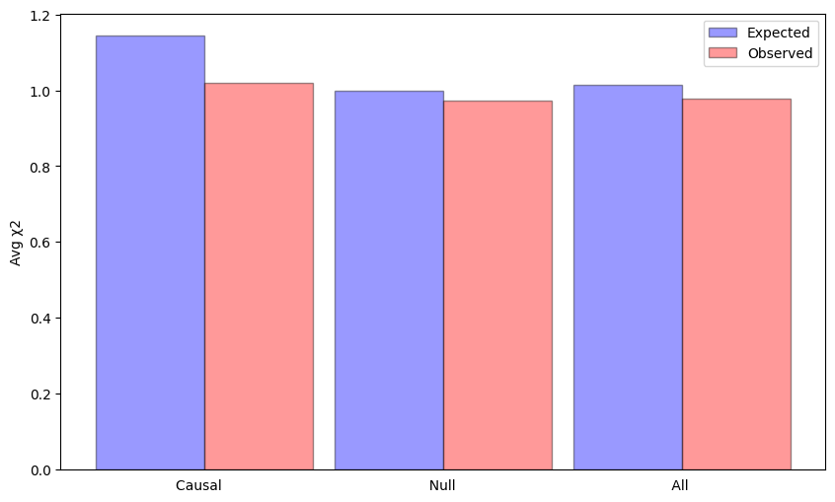
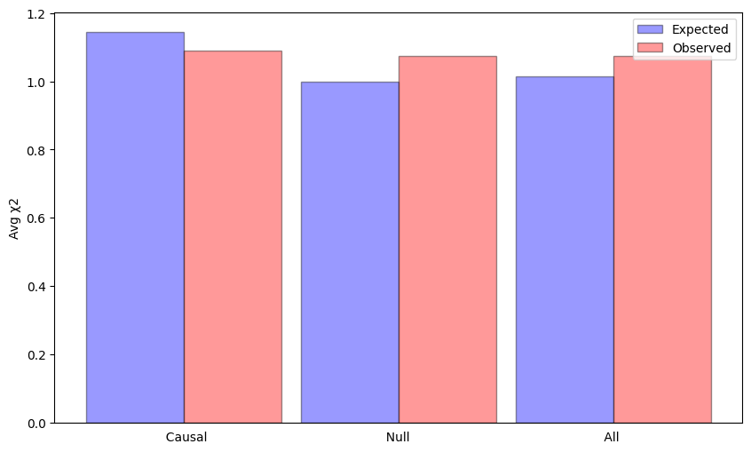
Hypertension PRS for ASW data
Normal PRS χ² values
 | Expected | Observed
Causal | 1.145 | 1.021
Null | 1 | 0.974
All | 1.014 | 0.977
Normal PRS
GAUDI
GAUDI PRS χ² values
 | Expected | Observed
Causal | 1.145 | 1.089
Null | 1 | 1.074
All | 1.014 | 1.075

Slide 13
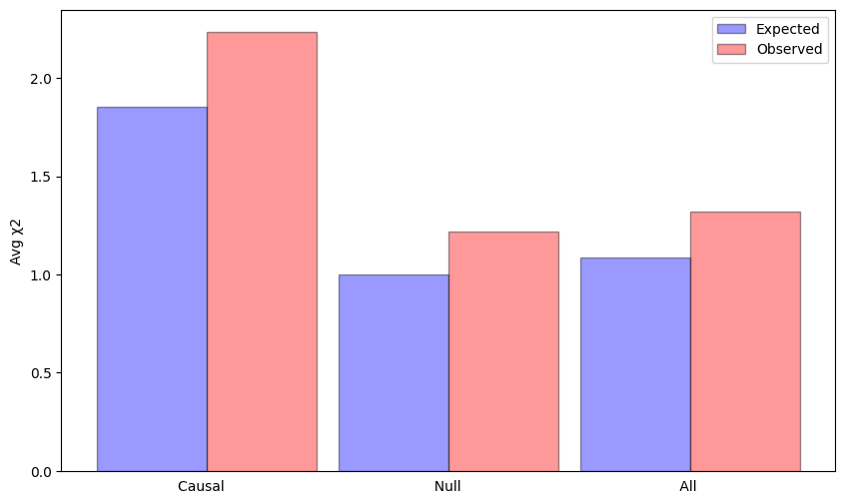
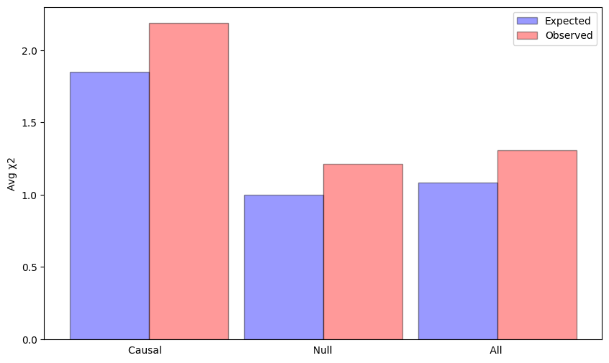
Type 1 Diabetes PRS for simulated data
Normal PRS χ² values
 | Expected | Observed
Causal | 1.852 | 2.330
Null | 1 | 1.229
All | 1.085 | 1.339
Normal PRS
GAUDI
GAUDI PRS χ² values
 | Expected | Observed
Causal | 1.852 | 2.283
Null | 1 | 1.220
All | 1.085 | 1.317

Slide 14
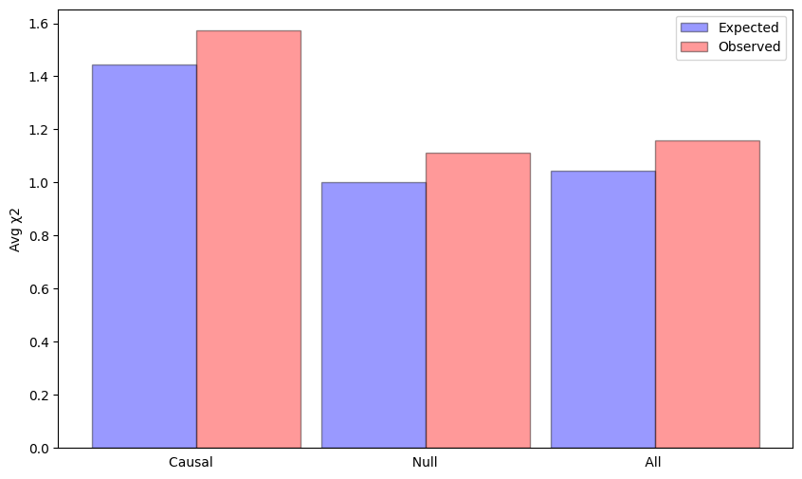

Hypertension PRS for simulated data
Normal PRS χ² values
 | Expected | Observed
Causal | 1.445 | 1.574
Null | 1 | 1.111
All | 1.045 | 1.157
Normal PRS
GAUDI
GAUDI PRS χ² values
 | Expected | Observed
Causal | 1.445 | 1.577
Null | 1 | 1.111
All | 1.045 | 1.157

Slide 15
Conclusions
Were able to simulate an admixed population and validated expected behaviour in PCA plot, LD-admixture and model-based clustering using STRUCTURE software.
Used the known admixed population data (ASW) and simulated data to acquire local ancestry probabilities
Used these local ancestry probabilities along with individual genotype data to perform more accurate polygenic risk prediction on simulated datasets
Future work includes fine tuning the simulation parameters to get a biologically more accurate admixed population.
We would also like to perform this experiment on other known admixed populations to see how polygenic risk prediction varies across different admixed populations

Slide 16
Thank You!

Slide 17
References
FALUSH D, STEPHENS M, PRITCHARD JK. Inference of population structure using multilocus genotype data: dominant markers and null alleles. Molecular Ecology Notes. 2007;7(4):574-578. doi:https://doi.org/10.1111/j.1471-8286.2007.01758.x
Sun, Q., Rowland, B.T., Chen, J. et al. Improving polygenic risk prediction in admixed populations by explicitly modeling ancestral-differential effects via GAUDI. Nat Commun 15, 1016 (2024). https://doi.org/10.1038/s41467-024-45135-z
Browning SR, Waples RK, Browning BL. Fast, accurate local ancestry inference with FLARE. Am J Hum Genet. 2023 Feb 2;110(2):326-335. doi: 10.1016/j.ajhg.2022.12.010. Epub 2023 Jan 6. PMID: 36610402; PMCID: PMC9943733.

